Slide 1

CAR PRICE PREDICTION PROJECT
Submitted by:
ANISH ANTONY

Slide 2
ABSTRACT:
With the covid 19 impact in the market, we have seen lot of changes in the car market. Now some cars are in demand hence making them costly and some are not in demand hence cheaper. One of our clients works with small traders, who sell used cars. With the change in market due to covid 19 impact, our client is facing problems with their previous car price valuation machine learning models. So, they are looking for new machine learning models from new data. We have to make car price valuation model. To predict this model, we need to scrape the used car details from online websites using selenium web driver, and the data have preprocessed, trained and tested using the regression algorithms. Then it is hypertuned and best algorithm with best parameters is obtained and finally the selling price of the car is predicted.
Keywords: Cars ,Selenium ,Data cleaning ,Selling Price ,Regression

Slide 3
The features used in the dataset are:
Registration Year
Make
Model
KMs Driven
No of Owners
Transmission
Fuel Type
Mileage
Location
Selling Price

Slide 4
Data Cleaning:
Registration Year – (Converted to object)
Make – (Extracted from Name)
Model – (Extracted from Name)
KMs Driven – (Removed the string and converted to integer)
No of Owners - (Made as unique variables for all websites)
Transmission – If not available in some websites, then give the data as not available
Fuel Type - (Made as unique variables for all websites)
Registration – If not available in some websites, then give the data as not available
Location – (Based on the location give the location)
Selling Price – (Removed the string and converted to integer)

Slide 5
Dataset Description:
S.NO | Columns | Datatype | Unique values | Mode/Mean
1 | Registration Year | int64 | 28 | 2013.56283
2 | Make | object | 29 | Maruti
3 | Model | object | 1155 | Maruti Suzuki Swift VXi
4 | KMs Driven | int64 | 629 | 77207.429351
5 | No of Owners | object | 4 | First
6 | Transmission | object | 3 | Manual
7 | Fuel Type | object | 9 | Petrol
8 | Location | object | 6 | Coimbatore
9 | Selling Price | int32 | 805 | 607882.439353

Slide 6
Hardware and Software Requirements and Tools Used:
Hardware – PC Windows 10, 4 GB Ram
Software – Google chrome, MS Excel, Python, Selenium webdriver
Libraries – Pandas, NumPy, Matplotlib, Seaborn, sklearn, SciPy. Stats
Browsing – Google Chrome
Webscraping – Python, Selenium webdriver
Data cleaning – Python, Pandas, NumPy & SciPy. Stats
Data visualization – Matplotlib & Seaborn
Machine learning – Sklearn

Slide 7
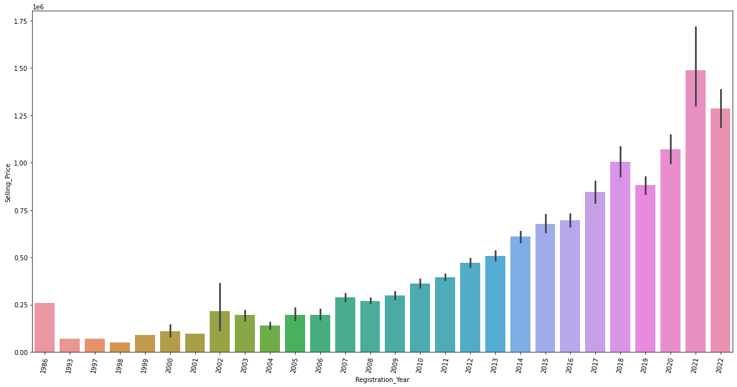
Registration Year:

Slide 8
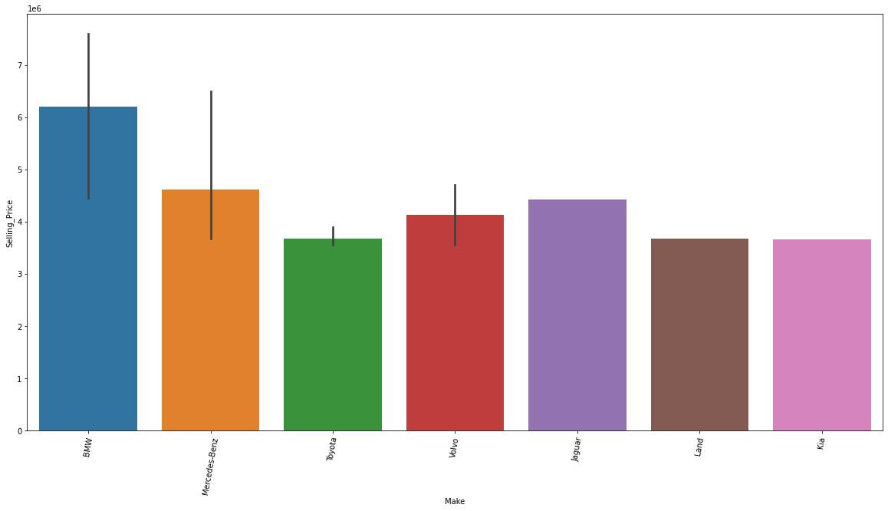
Make:

Slide 9
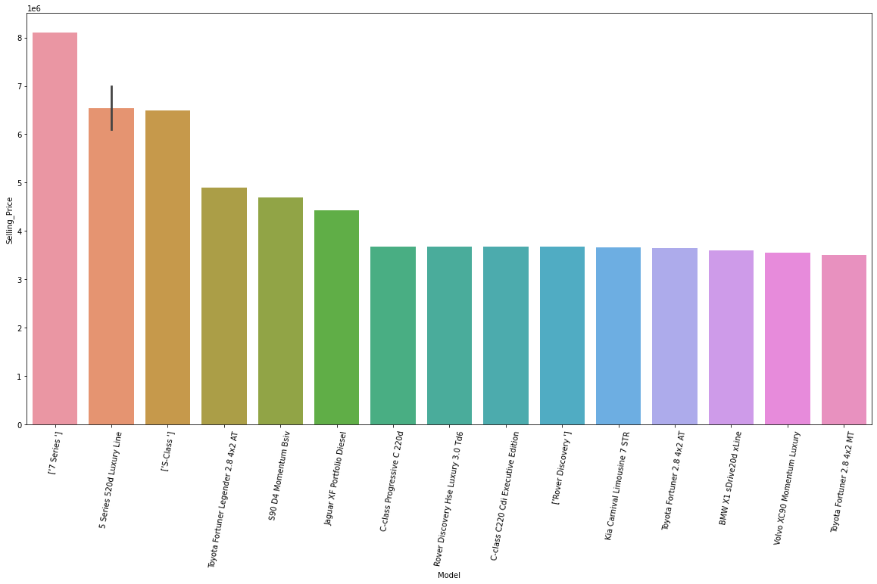
Model:

Slide 10
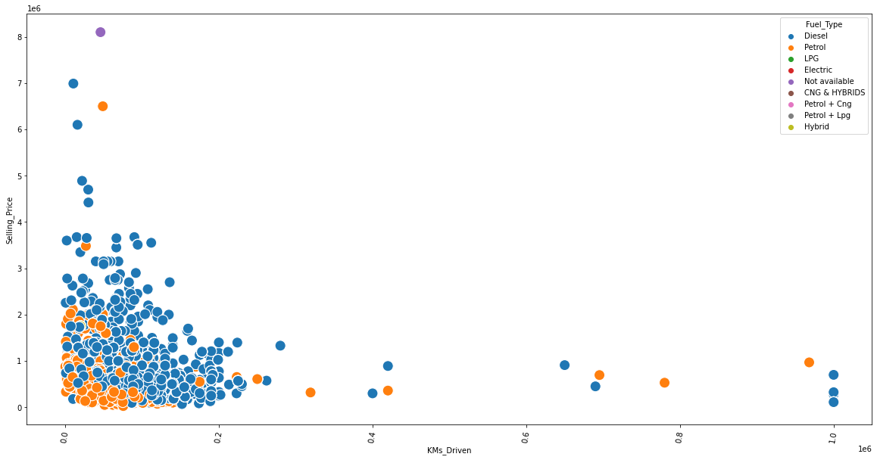
KM’s driven:

Slide 11
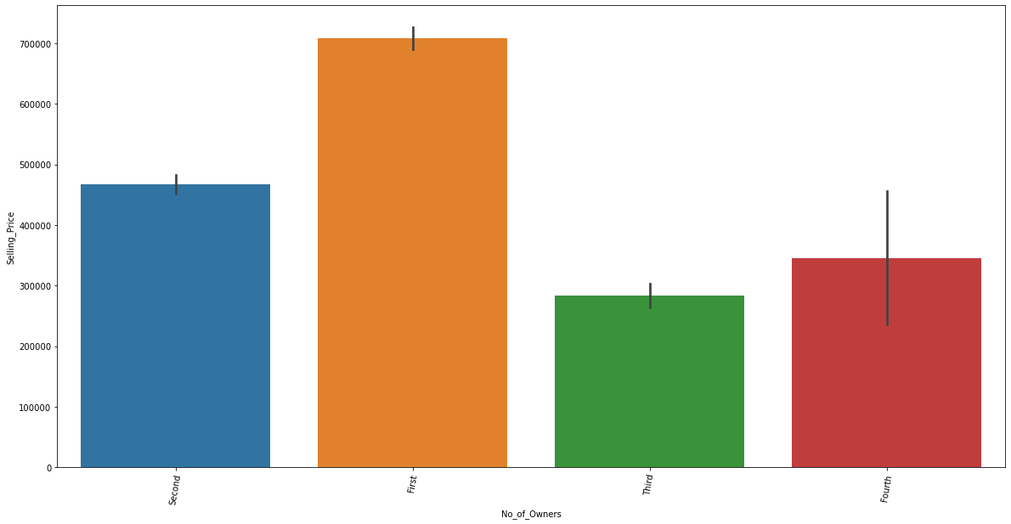
No of owners:

Slide 12
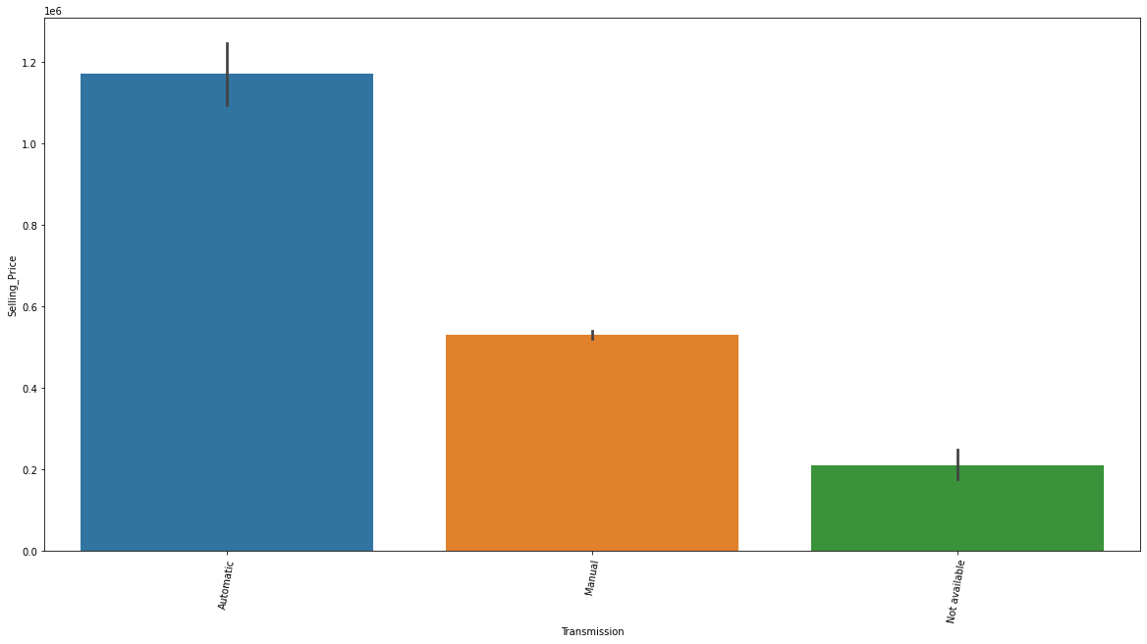
Transmission:

Slide 13
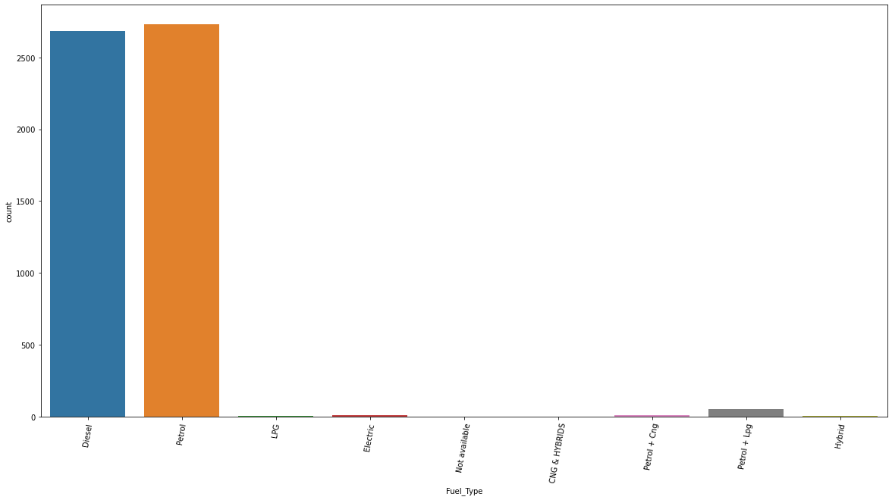
Fuel Type:

Slide 14
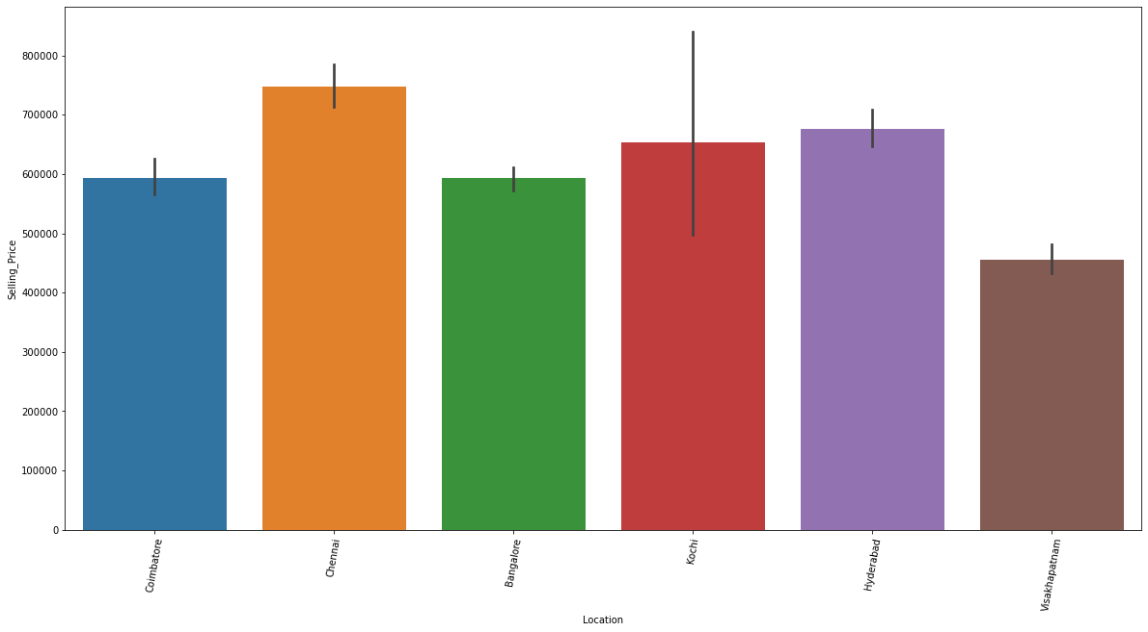
Location

Slide 15
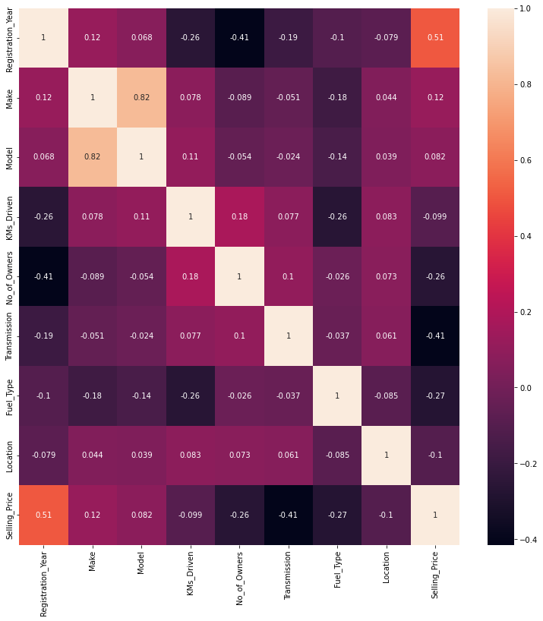
Heatmap:

Slide 16
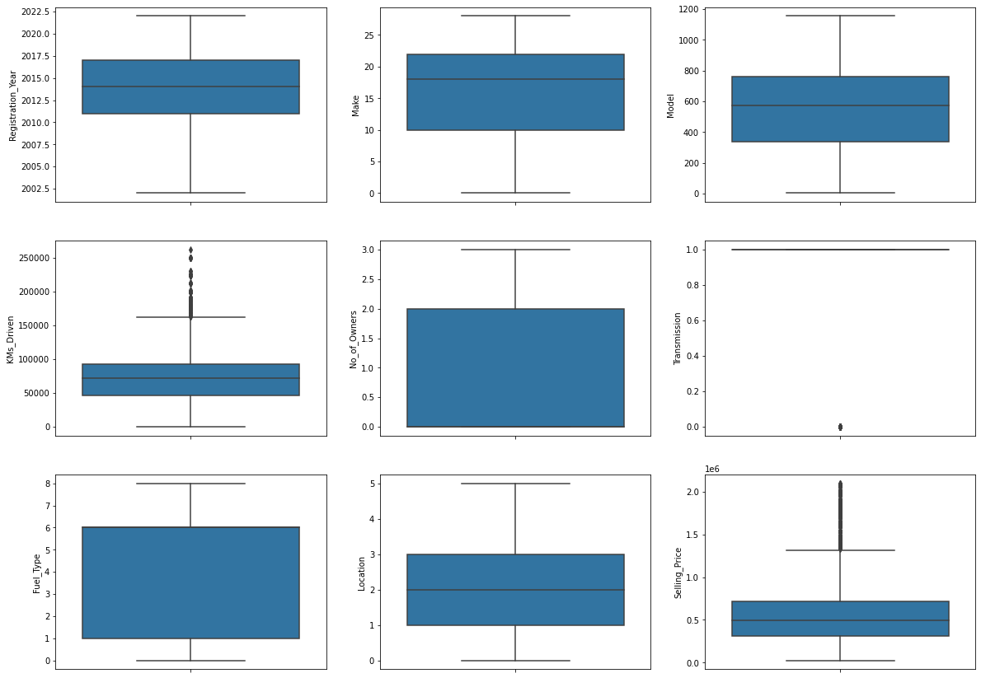
Boxplot:

Slide 17
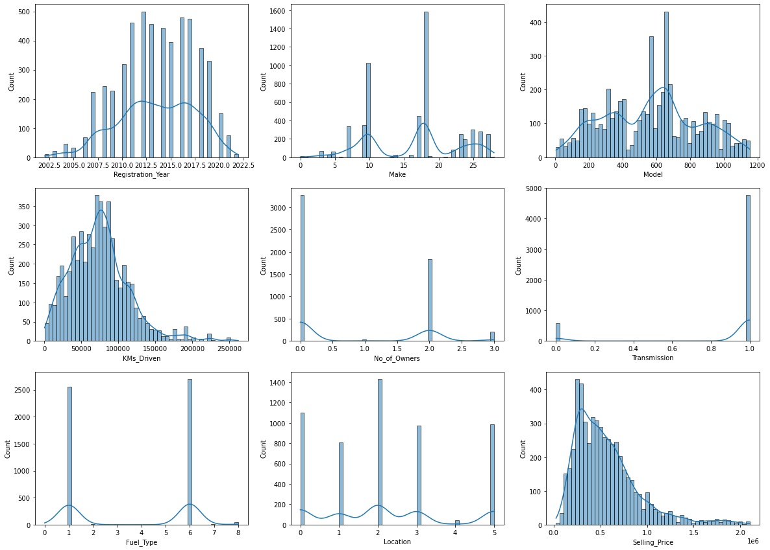
Histogram:

Slide 18
Testing of Identified Approaches (Algorithms):
Linear Regression
Gradient Boosting Regressor
AdaBoost Regressor
Decision Tree Regressor
KNeighbors Regressor
Extra Trees Regressor
Random Forest Regressor

Slide 19
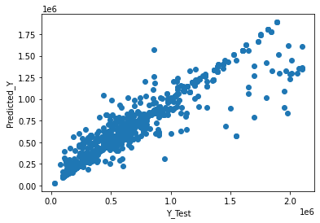
Y test plot:

Slide 20
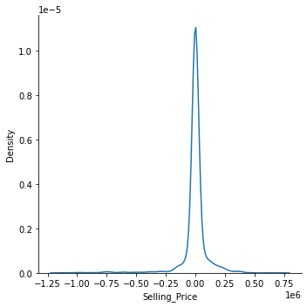
Distribution of Predicted Values:

Slide 21
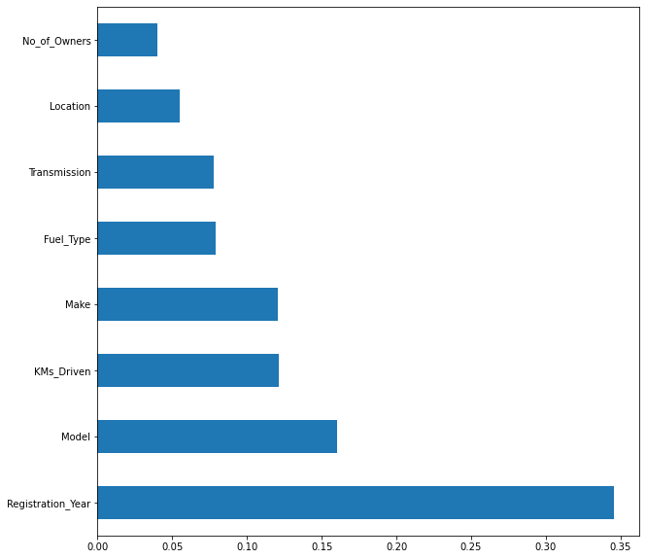
Feature importance’s

Slide 22
Accuracy Parameter:
• R2 Score: 88.5718027742514
• Mean Absolute Error: 43667.17472188806
• Mean squared Error: 14141070734.25445
• Root Mean Absolute Error: 208.96692255447527
The best model is obtained by Hypertuning the existing models.

Slide 23
Key Findings and Conclusions of the Study:
This dataset has been taken from 3 websites of this, Droom website constitutes the majority of data
Since the target feature is continuous data, this problem can be solved by regression algorithms
Random Forest Regression gives an R2 score 0.88
Registration year dominates the selling price more.

